Slide 1
NTU 2020 Spring Machine Learning
Self-Supervised Learning
Chi-Liang Liu, Hung-Yi Lee
NTU
Refer to UCB CS294-158-SP20

Slide 2
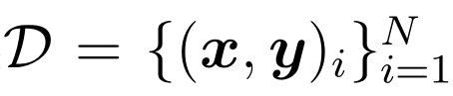
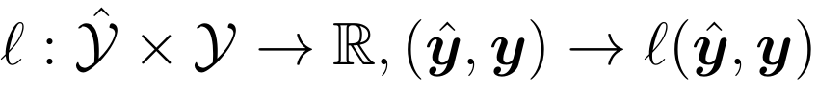
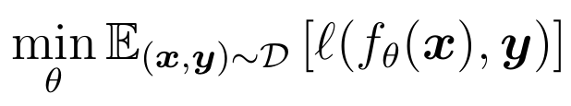
Previously on this Course
Supervised Learning
Given: a dataset and a loss function Goal:
Works well when labeled data is abundant.
Learn useful representation with the supervision.
Problem: Can we learn useful representation without the supervision?

Slide 3


Why Self-Supervised Learning?
Labeled Data
Unlabeled Data
Slide: Thang Luong

Slide 4
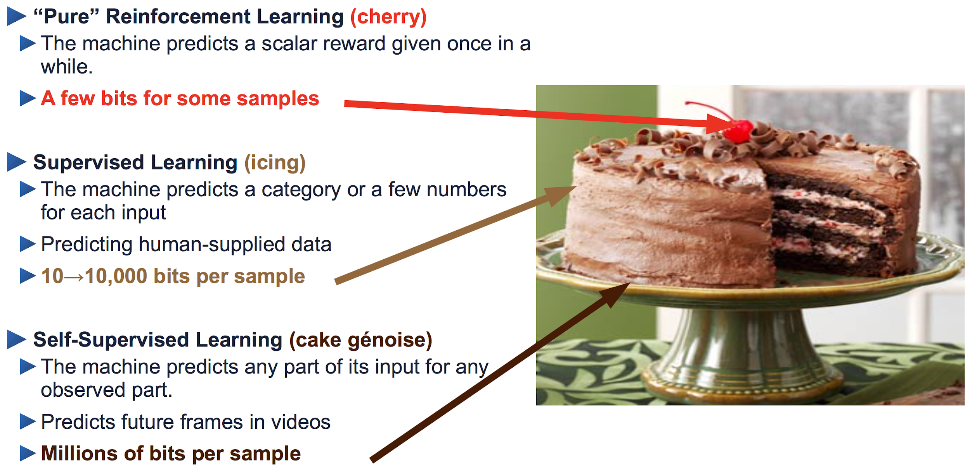
Why Self-Supervised Learning?
Yann LeCun’s cake

Slide 5
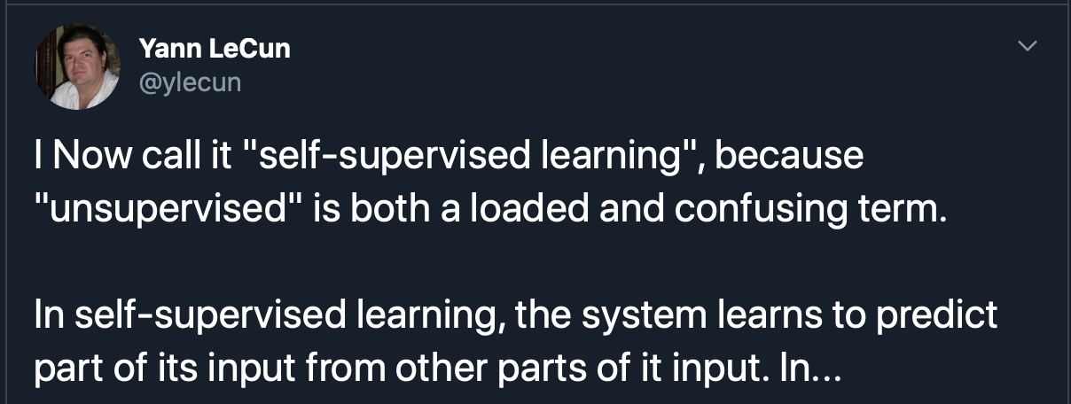
What is Self-Supervised Learning?
A version of unsupervised learning where data provides the supervision.
In general, withhold some part of the data and the task a neural network to predict it from the remaining parts.
Goal: Learning to represent the world before learning tasks.

Slide 6
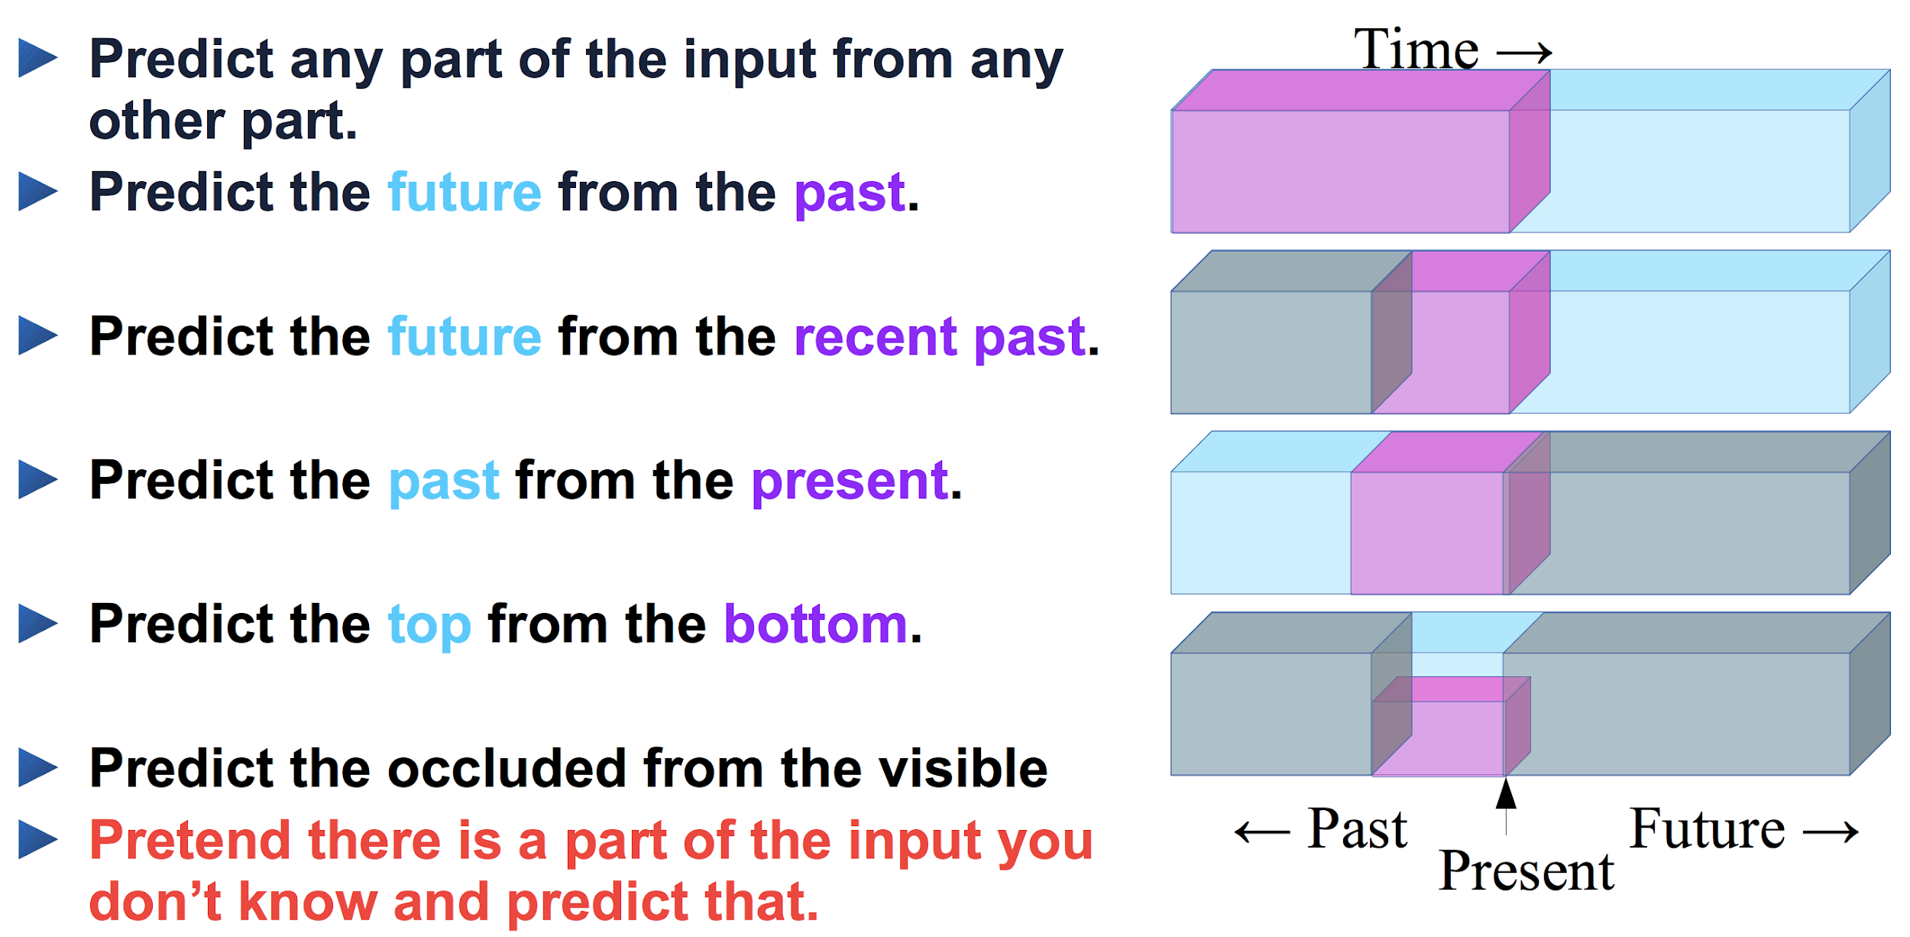
Self-Supervised Learning= Filling the Blanks
Slide: LeCun

Slide 7
Methods of Self-Supervised Learning
Reconstruct from a corrupted (or partial) data
Denoising Autoencoder
Bert-Family (Text)
In-painting (Imagae)
Visual common sense tasks
Jigsaw puzzles
Rotation
Contrastive Learning
word2vec
Contrastive Predictive Coding (CPC)
SimCLR

Slide 8
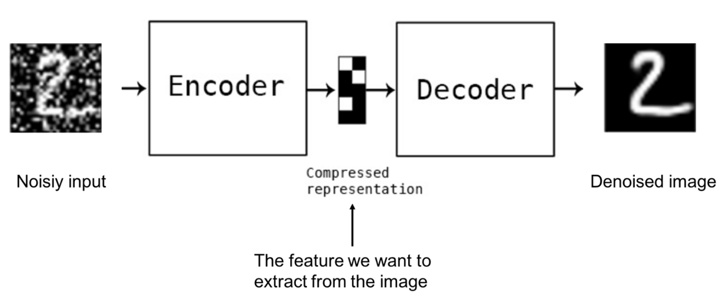
Denoising AutoEncoder
Slide: CS294-158

Slide 9
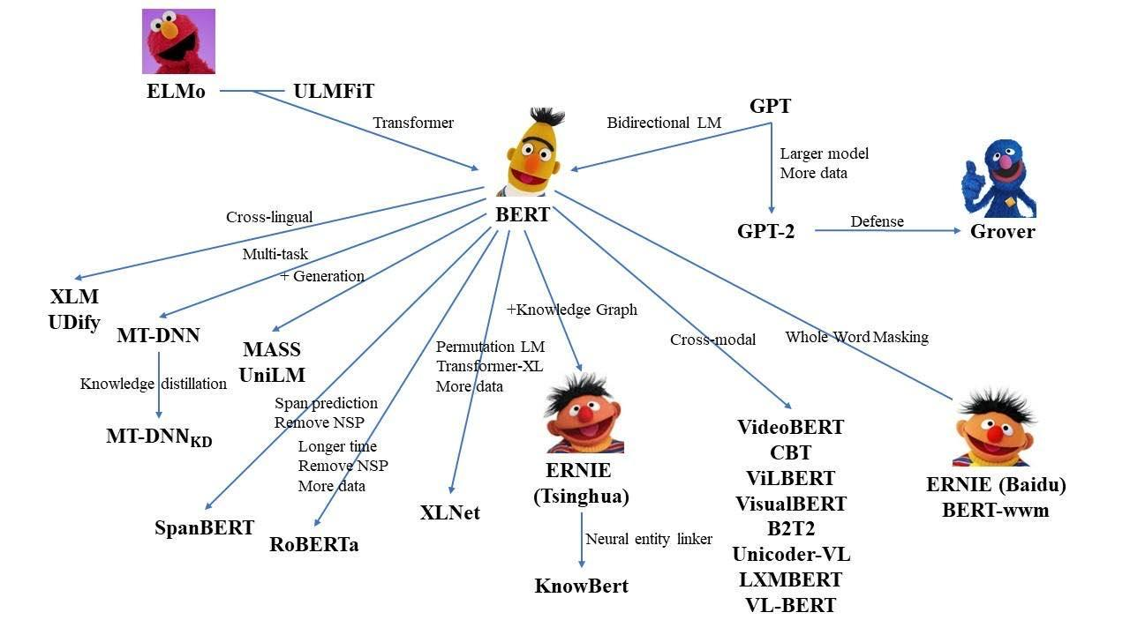
BERT-Family

Slide 10
Language Model
A statistical language model is a probability distribution over sequences of words. Given such a sequence, say of length m, it assigns a probability to the whole sequence. ex. P("Is it raining now?") > P("Is it raining yesterday?")
How to Compute?
n-gram model
Neural Network
Wiki: Language Model

Slide 11
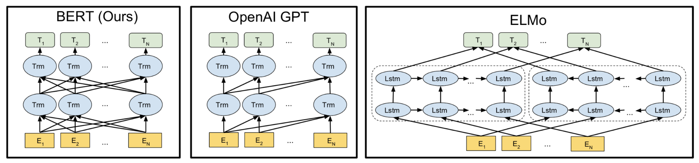
ELMO & GPT & BERT
Devlin et al. 2018

Slide 12
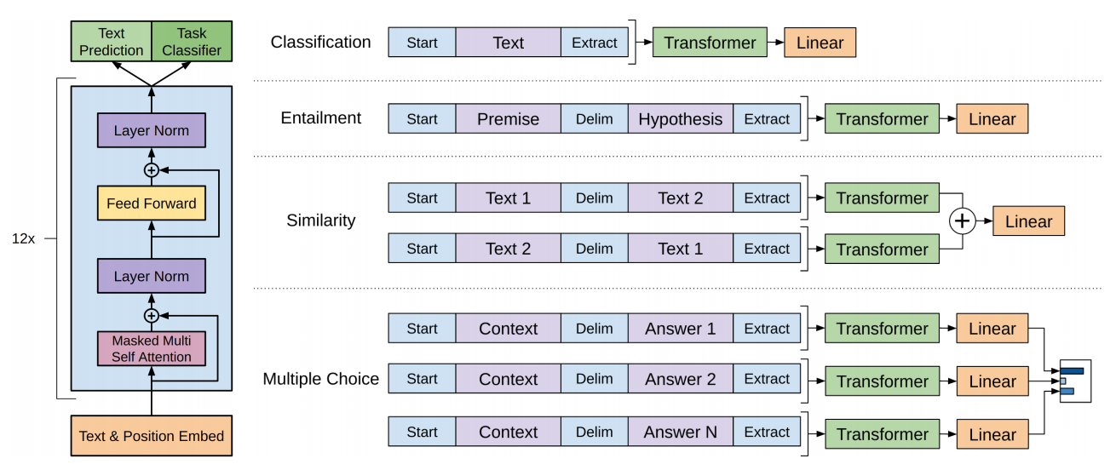
GPT - Language Model
Radford et al. 2018

Slide 13
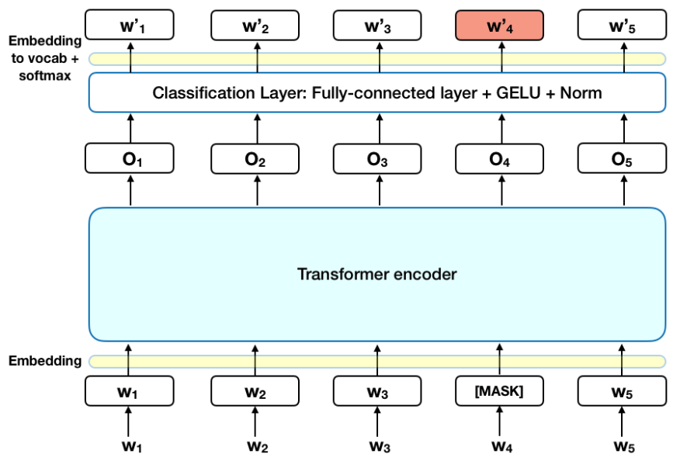
BERT - Masked LM
Masked LM:
Predict 15% of the tokens in the input.
80% replaced with a masked token
10% replaced with a random word
10% remain the same
ex.
Input: The [mask] sat on the [mask] . Output: The cat sat on the mat .

Slide 14
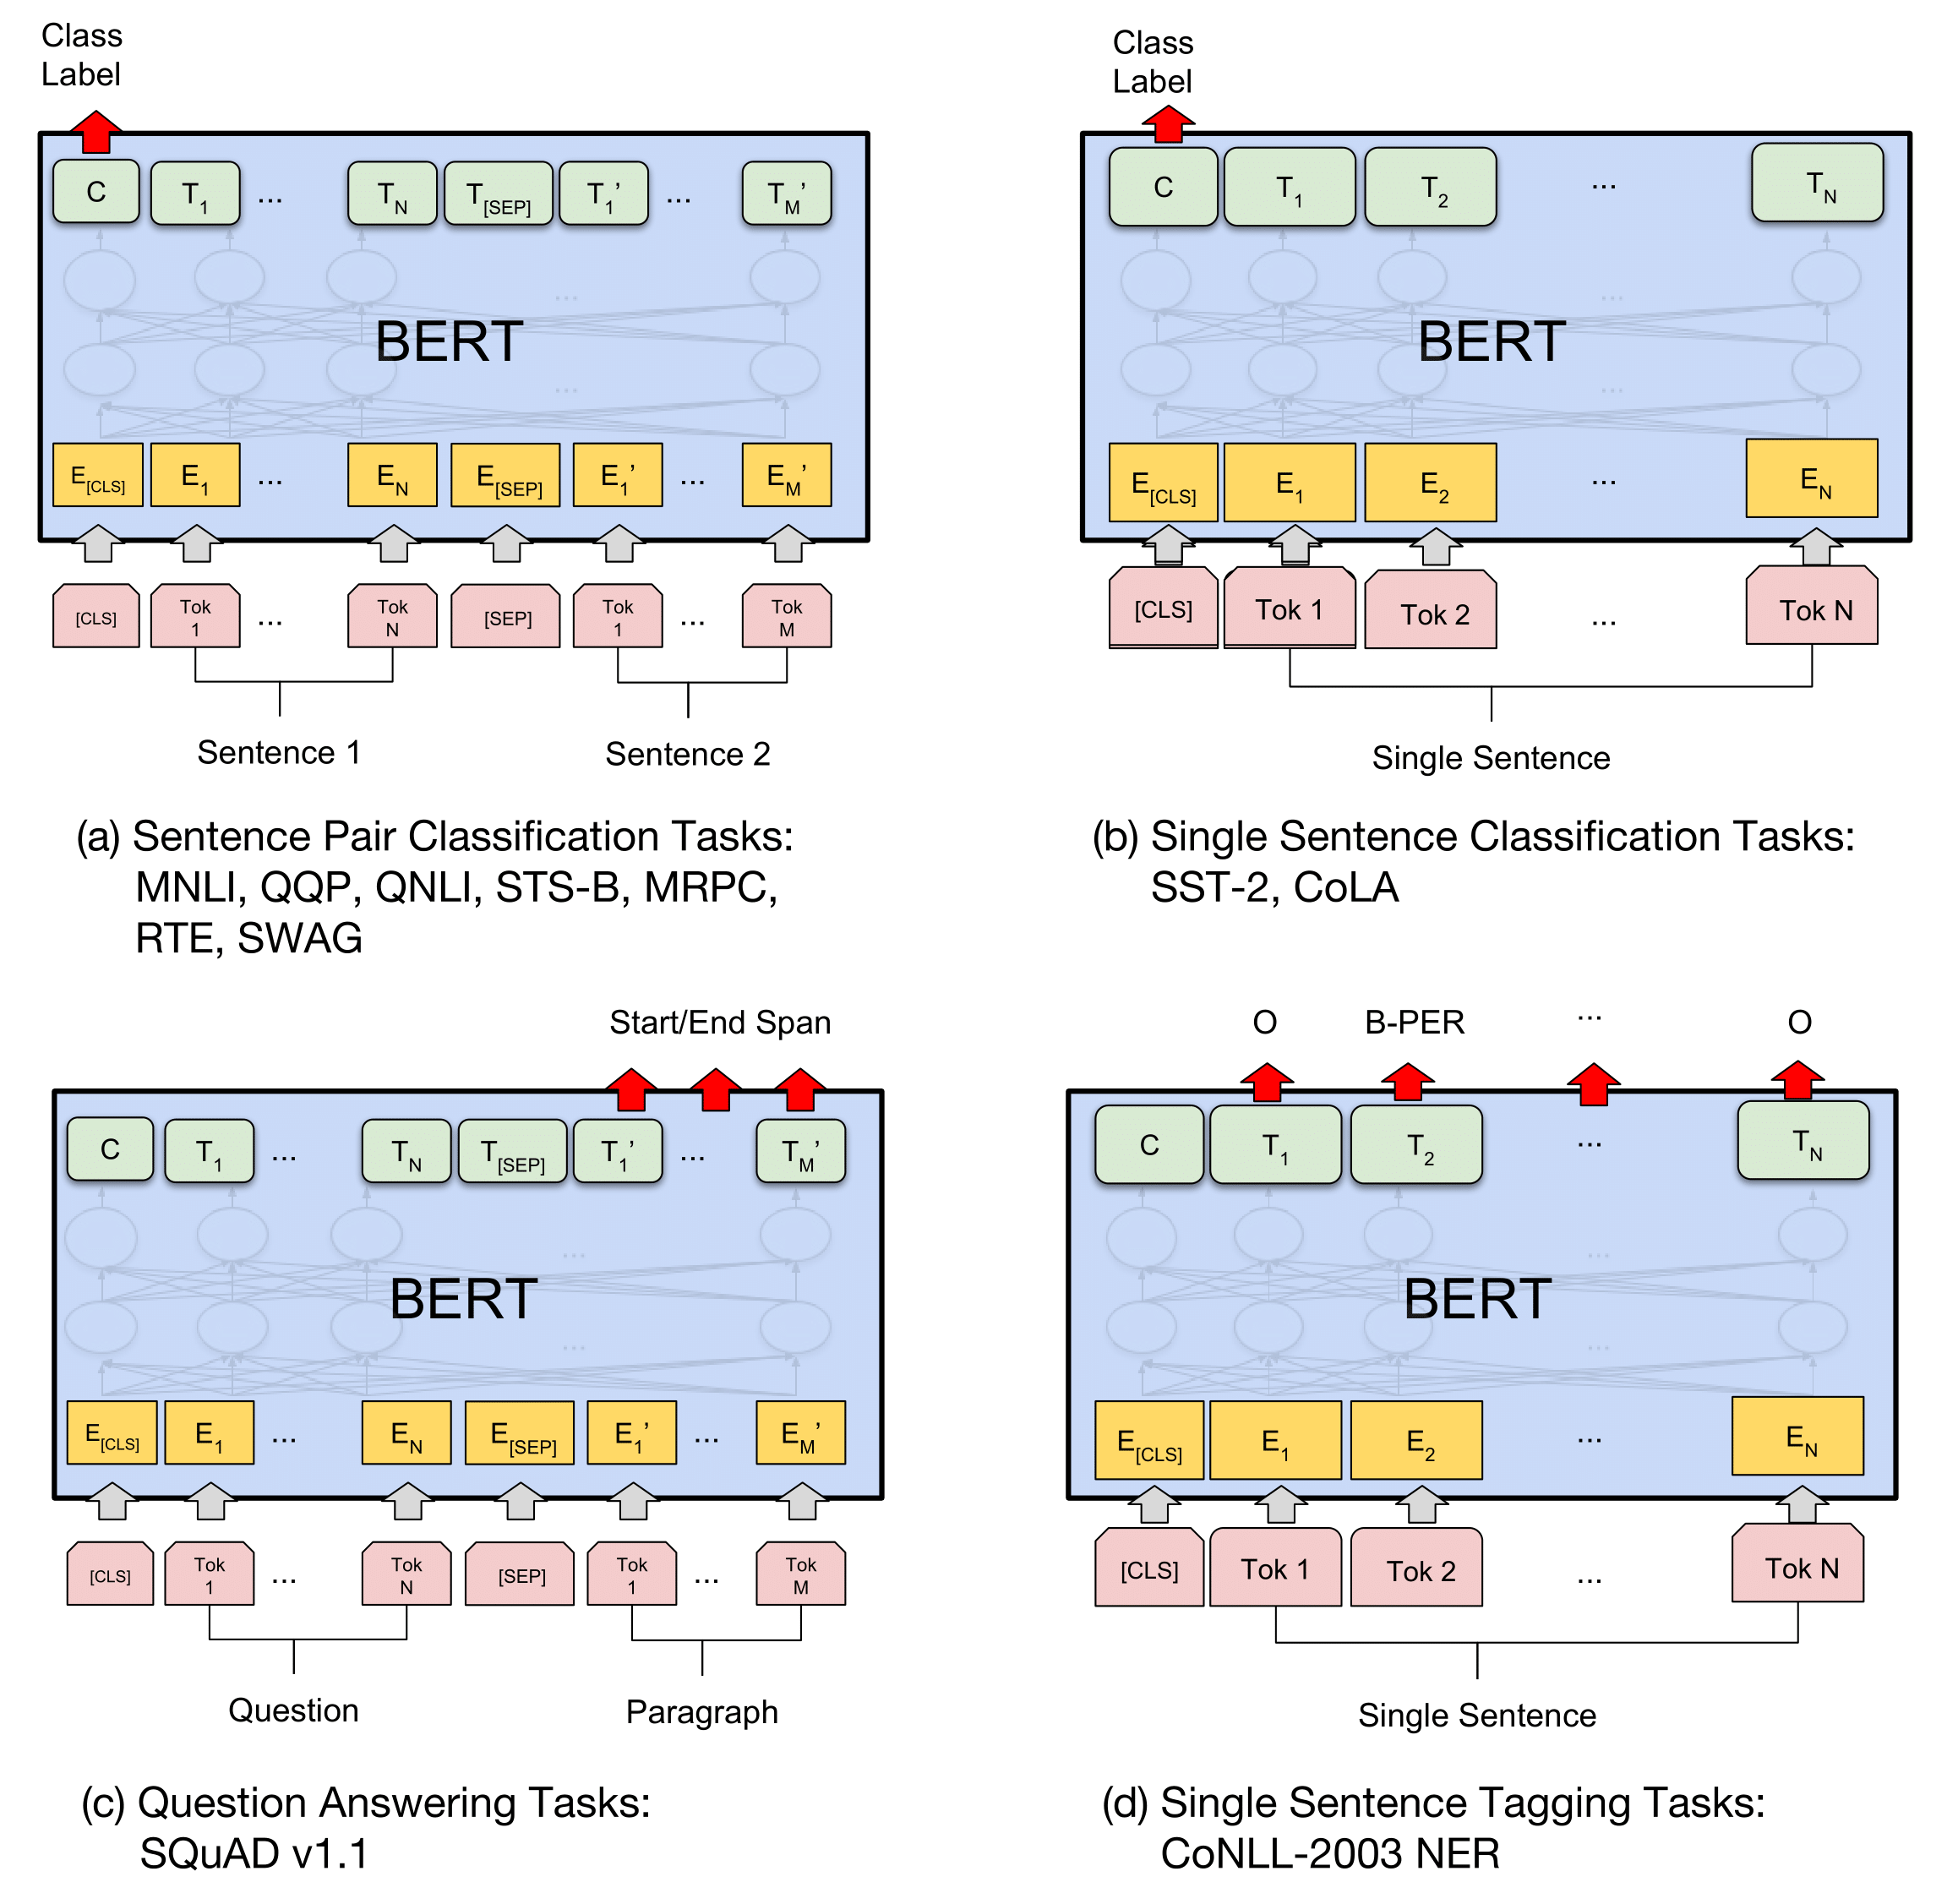
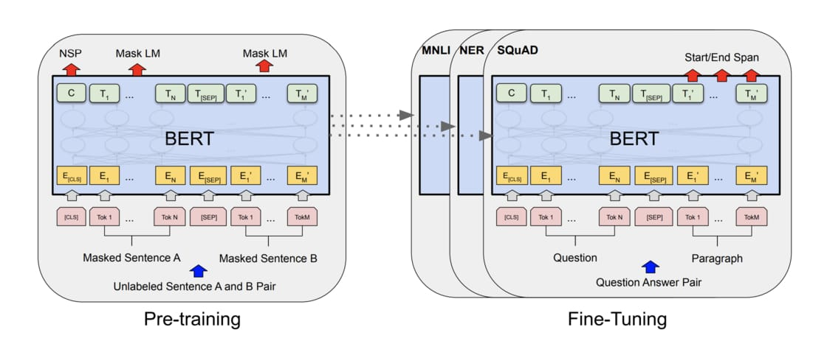
BERT - Pipeline
Devlin et al. 2018

Slide 15
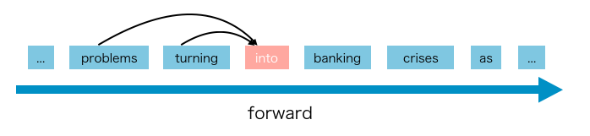
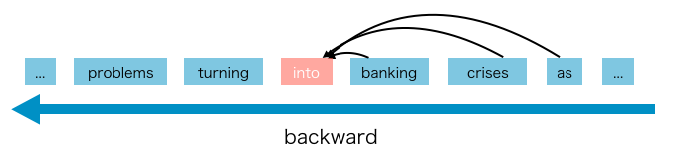
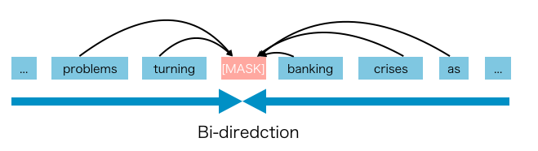
ARLM vs AELM
Autoregressive Language Model (ARLM)
Pro: Does not rely on data corruption
Con: Can only be forward or backward
Autoencoding Language Model (AELM a.k.a MaskedLM)
Pro: Can use bidirectional information (Context Dependency)
Con: Pretrain-Finetune discrepancy (Input Noise), Independence Assumption
Yang et al. 2019

Slide 16
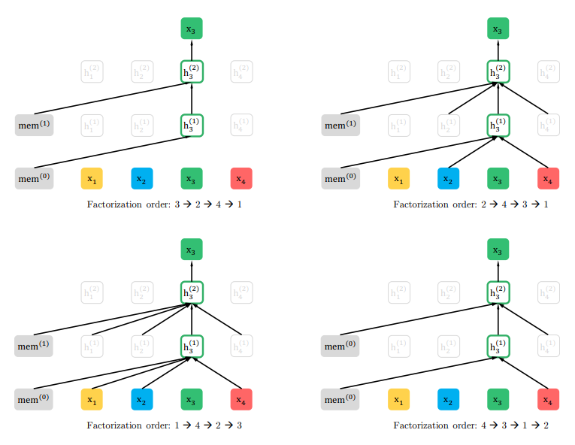
XLNet - Permutation LM
Permutation LM:
Step 1. Permutation
Step 2. Autoregressive
ex.
Given Sequence [x1, x2, x3, x4]
Step 1. [x1, x2, x3, x4] -> [x2, x4, x3, x1]
Step 2. Given [x2] predict [x2, x4]
-> Given [x2, x4] predict [x2, x4, x3]
-> Given [x2, x4, x3] predict [x2, x4, x3, x1]
Yang et al. 2019

Slide 17
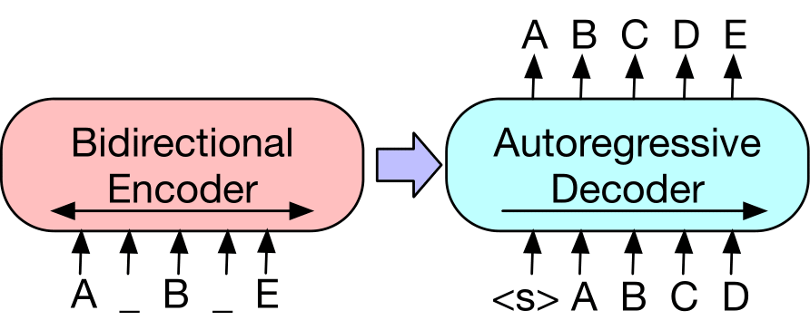
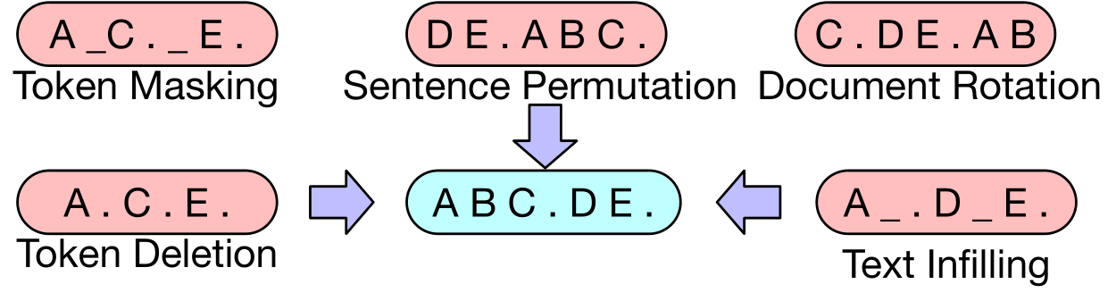
BART - Encoder & Decoder
Previous: Fixed-length to Fixed-length
BART:
Tasks:
Lewis et al. 2018

Slide 18
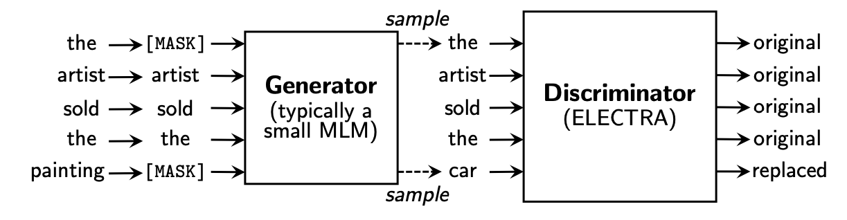
ELECTRA - Discriminator
Clark et al. 2018

Slide 19
Others
RoBERTa: A Robustly Optimized BERT Pretraining Approach
ALBERT: A LITE BERT FOR SELF-SUPERVISED LEARNING OF LANGUAGE REPRESENTATIONS

Slide 20
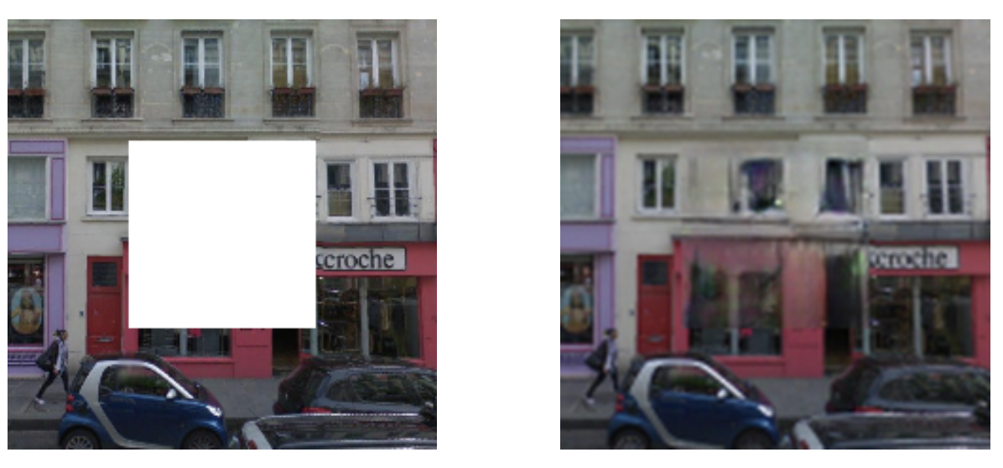
Predict missing pieces
Pathak et al. 2016 Slide: CS294-158

Slide 21
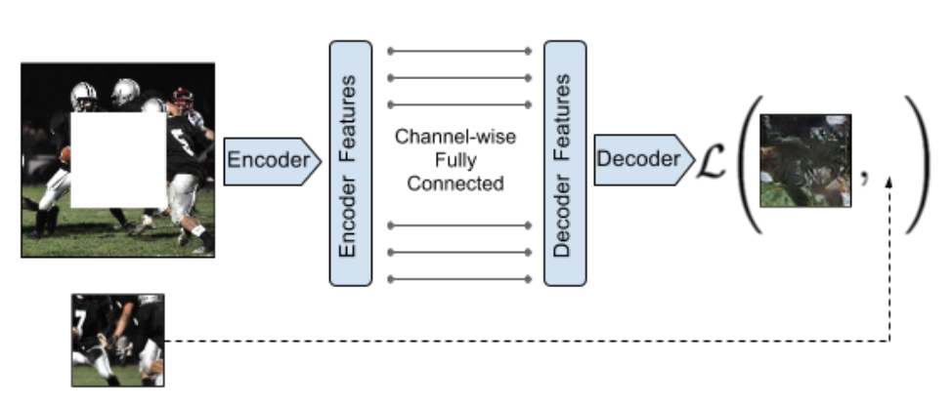
Pathak et al. 2016 Slide: CS294-158

Slide 22
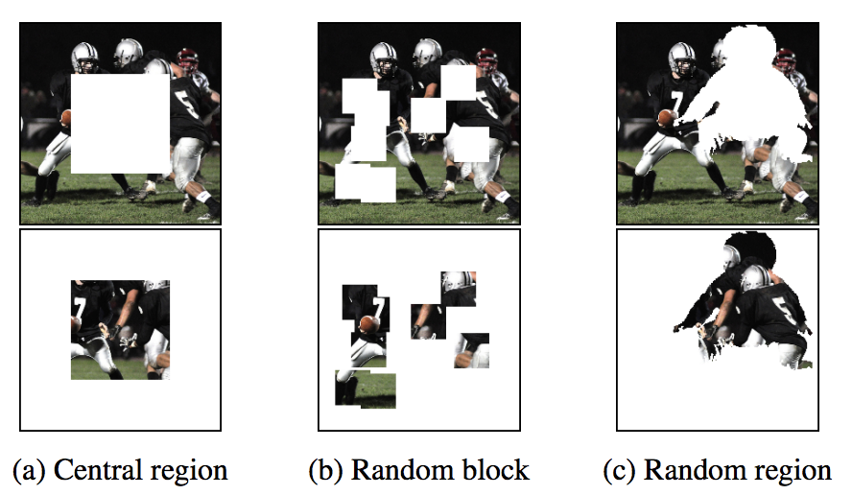
Context Encoder
Pathak et al 2016 Slide: CS294-158

Slide 23
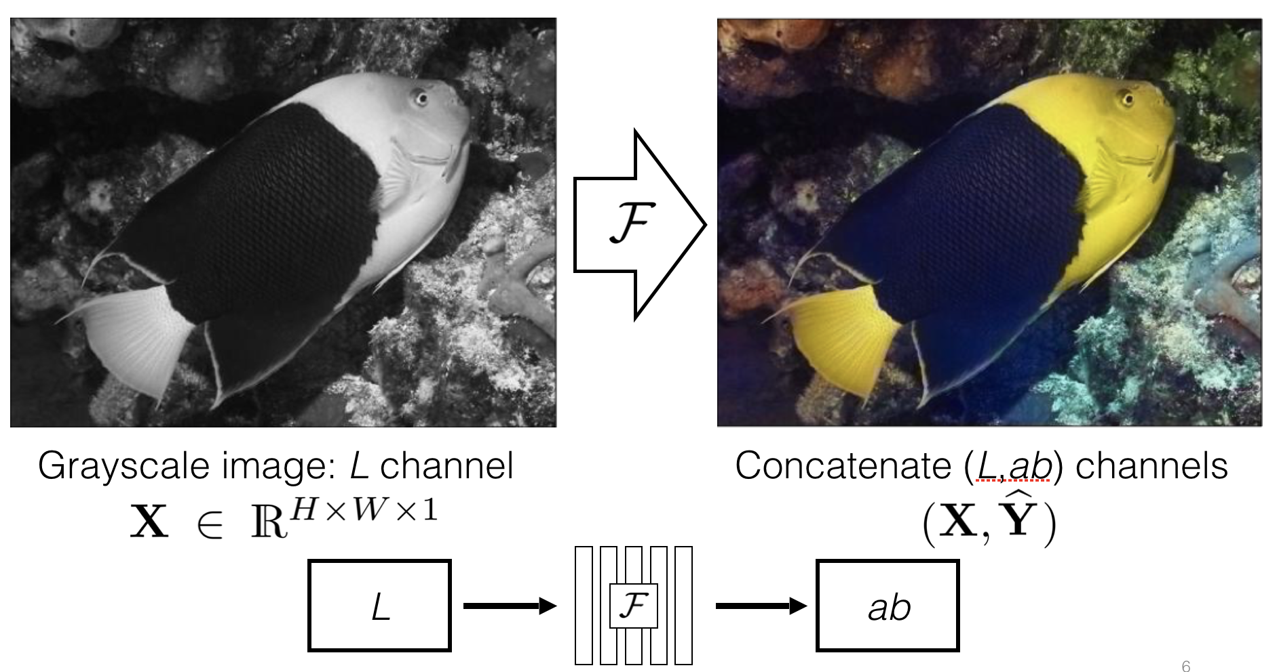

Predicting one view from another
Slide: Richard Zhang

Slide 24
Slide: Richard Zhang

Slide 25
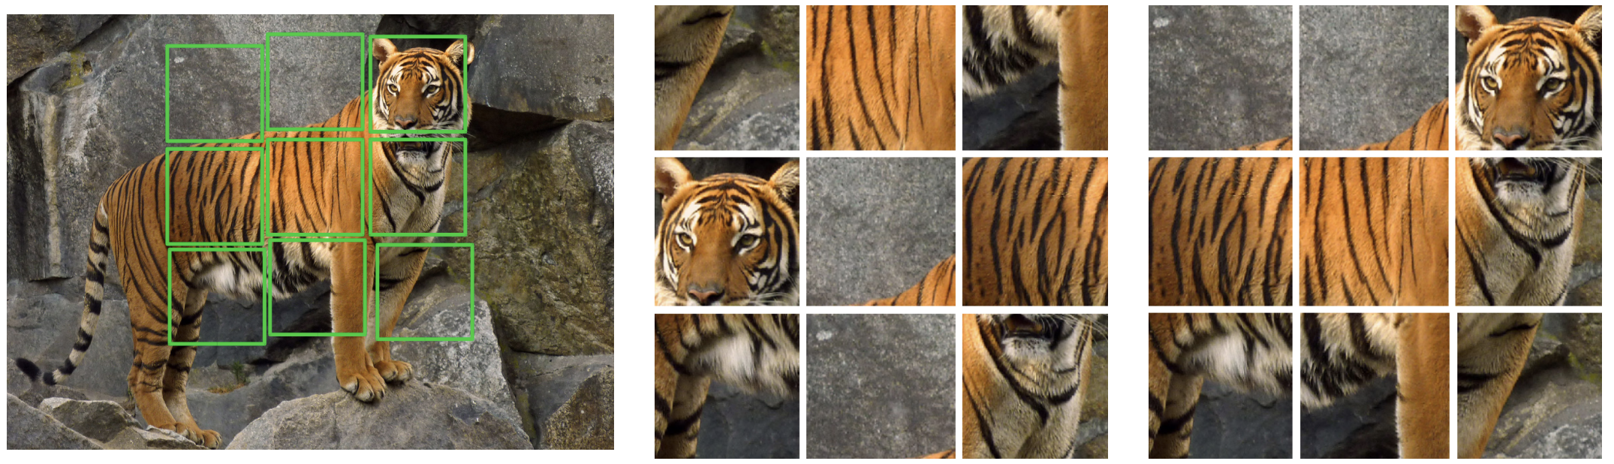
Solving Jigsaw Puzzles
Slide: CS294-158

Slide 26

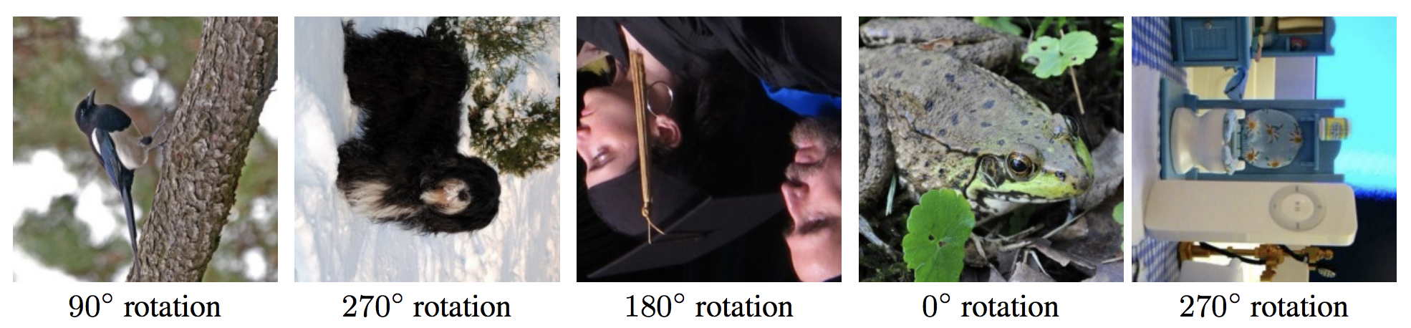
Rotation

Slide 27
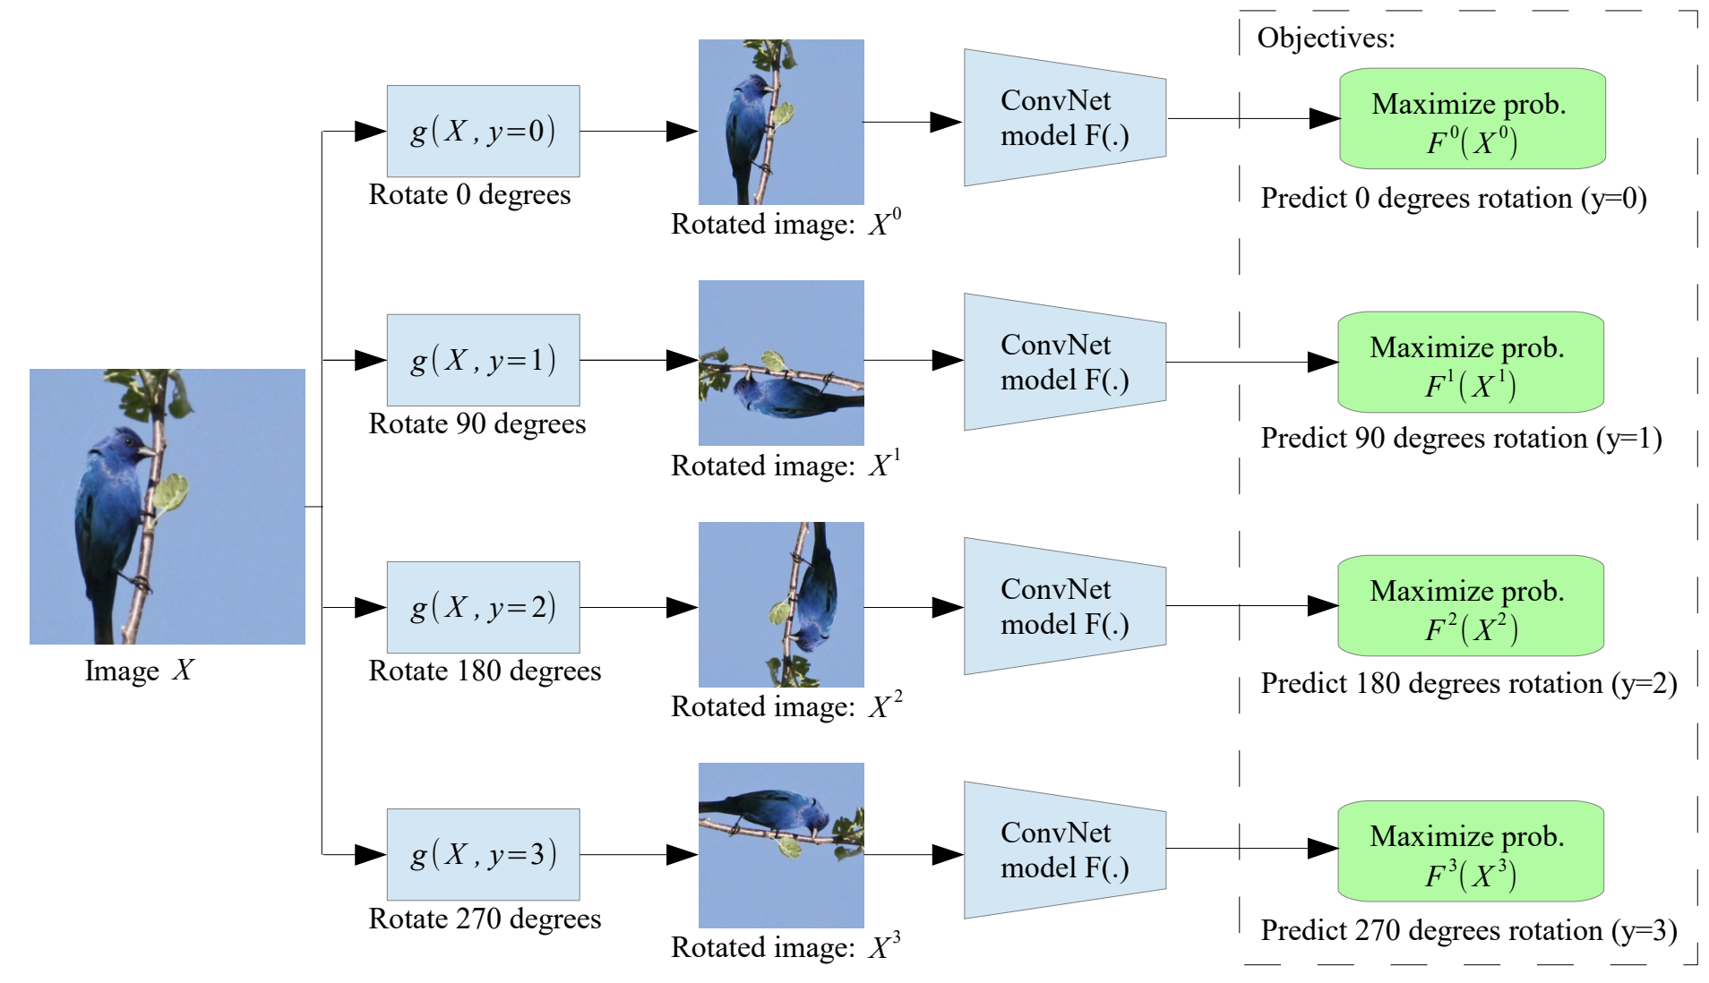
Rotation
Slide: CS294-158

Slide 28
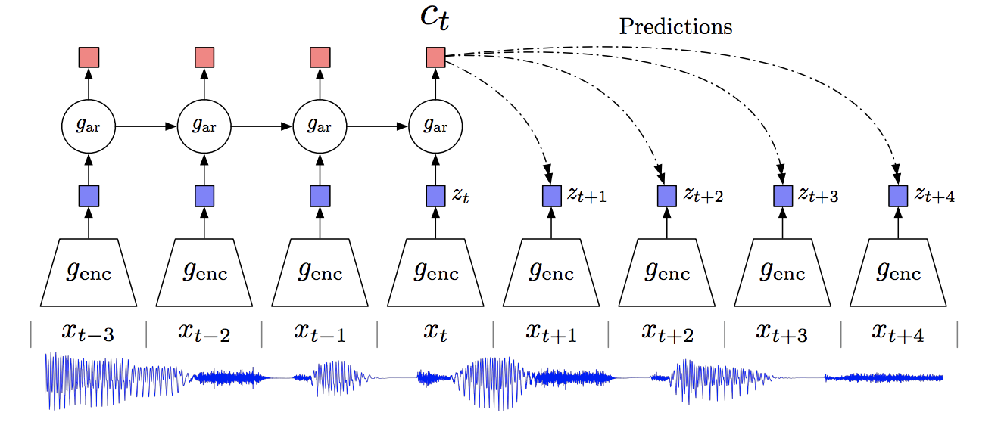
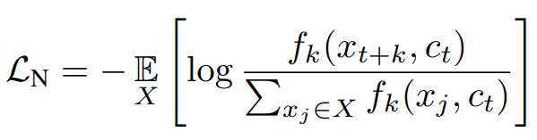
Contrastive Predictive Coding
Remember Word2Vec? They are almost the same idea.
van den Oord et al. 2020

Slide 29
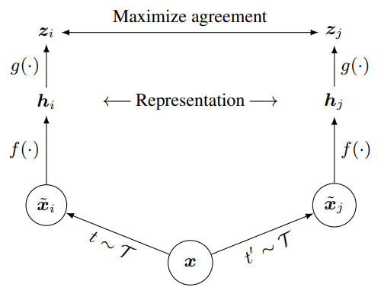

SimCLR
Chen et al. 2020

Slide 30
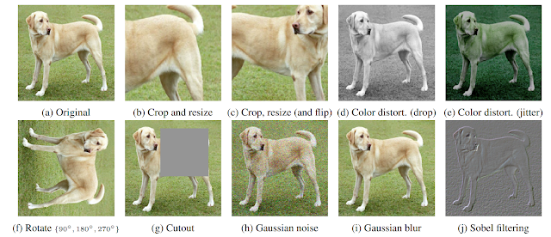
SimCLR

Slide 31
Reference
CS294-158 Deep Unsupervised Learning Lecture 7
AAAI 2020 Keynotes Turing Award Winners Event
Learning From Text - OpenAI
Learning from Unlabeled Data - Thang Luong

